Slide 1

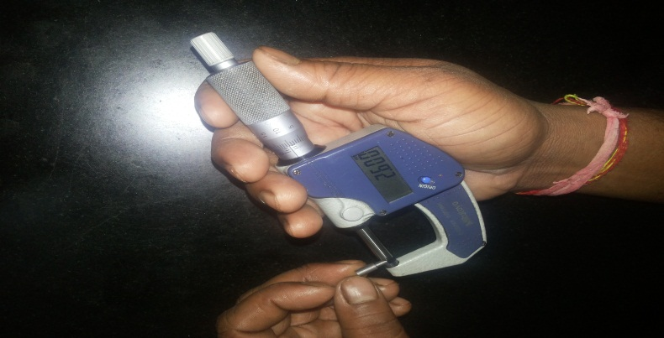
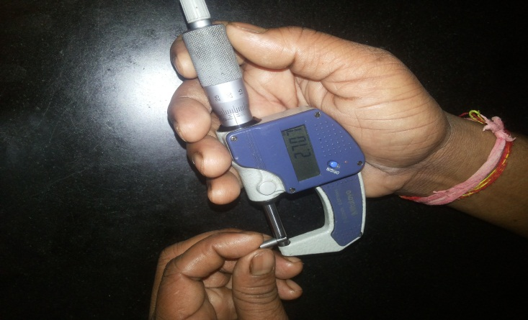
P15
KAIZEN NO :- 10
ACTIVITY
KK
QM
PM
JH
SHE
OT
DM
E&T
KAIZEN IDEA SHEET
TPM CIRCLE NAME: Achiever
LOSS NO. / STEP
DEPT :- MACHINE SHOP
RESULT AREA
P
Q
A,B,C
C
D
S
M
CELL:- D/C
CELL NAME:- A189 D/C
MACHINE / STAGE :- VMC WINNER
OPERATION :- Profile milling
KAIZEN THEME : To reduce cost of A189 dc
IDEA :- Pin Design to be Change.
Problem / Present Status : A189 profile machine locating pin breakage problem.
COUNTERMEASURE:- Profile milling locating pin diameter changed from 2.7 mm to 2.6 mm.
BENCHMARK Pin break age
TARGET
Pin breakage zero
KAIZEN START
08.06.2016
KAIZEN FINISH
10.06.2016
TEAM MEMBERS :
1.Someshwar Salunkhe.
2. Amol Patil
BENEFITS :-
A189 DC Profile Pin Breakage Cost Saved.
After
KAIZEN SUSTENANCE
RESULT :-
1. Profile pin breakage Eliminate.
2 . Breakdown time save.
WHAT TO DO :- Use Only Modified Pin
HOW TO DO :- Drawing Approved from Plant ME
WHY - WHY ANALYSIS :-
Why1:- A189 Profile pin breakage Problem.
Why2:- No Clearance between Pin & Part Hole.
Why3 :- Pin diameter & Part hole diameter are same.
Why3:- Basic pin design .
ROOT CAUSE :- Pin diameter & Part hole diameter are same.
SCOPE & PLAN FOR HORIZONTAL DEPLOYMENT
REGISTRATION NO. & DATE : 10.06.2016
SR.
NO.
CELL
TARGET
RESPONSIBILITY
STATUS
REGISTERED BY :- Amol Patil.
1
-------
-------
--------
-----
MANAGER’S SIGN :- D. Y Pawar

